Slide 1


Module 6 – Create and Manage Data Products

Slide 2
Data Asset vs Data Product
Data Asset
Data Product
Definition – a data asset is an individual item of data, such as table, file, or report.
It represents a single piece of data that can be cataloged, managed and governed
Definition – a data product is a collection of related data assets grouped together to serve a specific business case
It provides context and a comprehensive view of related data assets, making it easier for data consumers to find and use the data
Notes:
Individual Data assets by themselves have limited value. They typically need to be packaged together with relationships, and have context provided to be more useful. For example, a single fact table of 'Sales' likely requires 'Customers', 'Sales Representatives', and 'Regions' dimension tables to make the sales data more useful for analysis or reporting.
This is where Data products come in. Within Purview, a Data product is a logical abstraction which represents a business concept with a name, description, owners, audience, update frequency, data quality score and most importantly a list of associated data assets – which is how we get the DQ score. A successful Data product makes it easy for data consumers to recognize valuable data using their day-to-day language, and at the same time streamlines ownership responsibilities for those data assets.
Data products can be published for consumption by end users throughout the organization. They can be associated with governance domain, business glossary terms, and objectives and key results (OKRs) to provide context and alignment with business goals (more on this in the next lab).

Slide 3
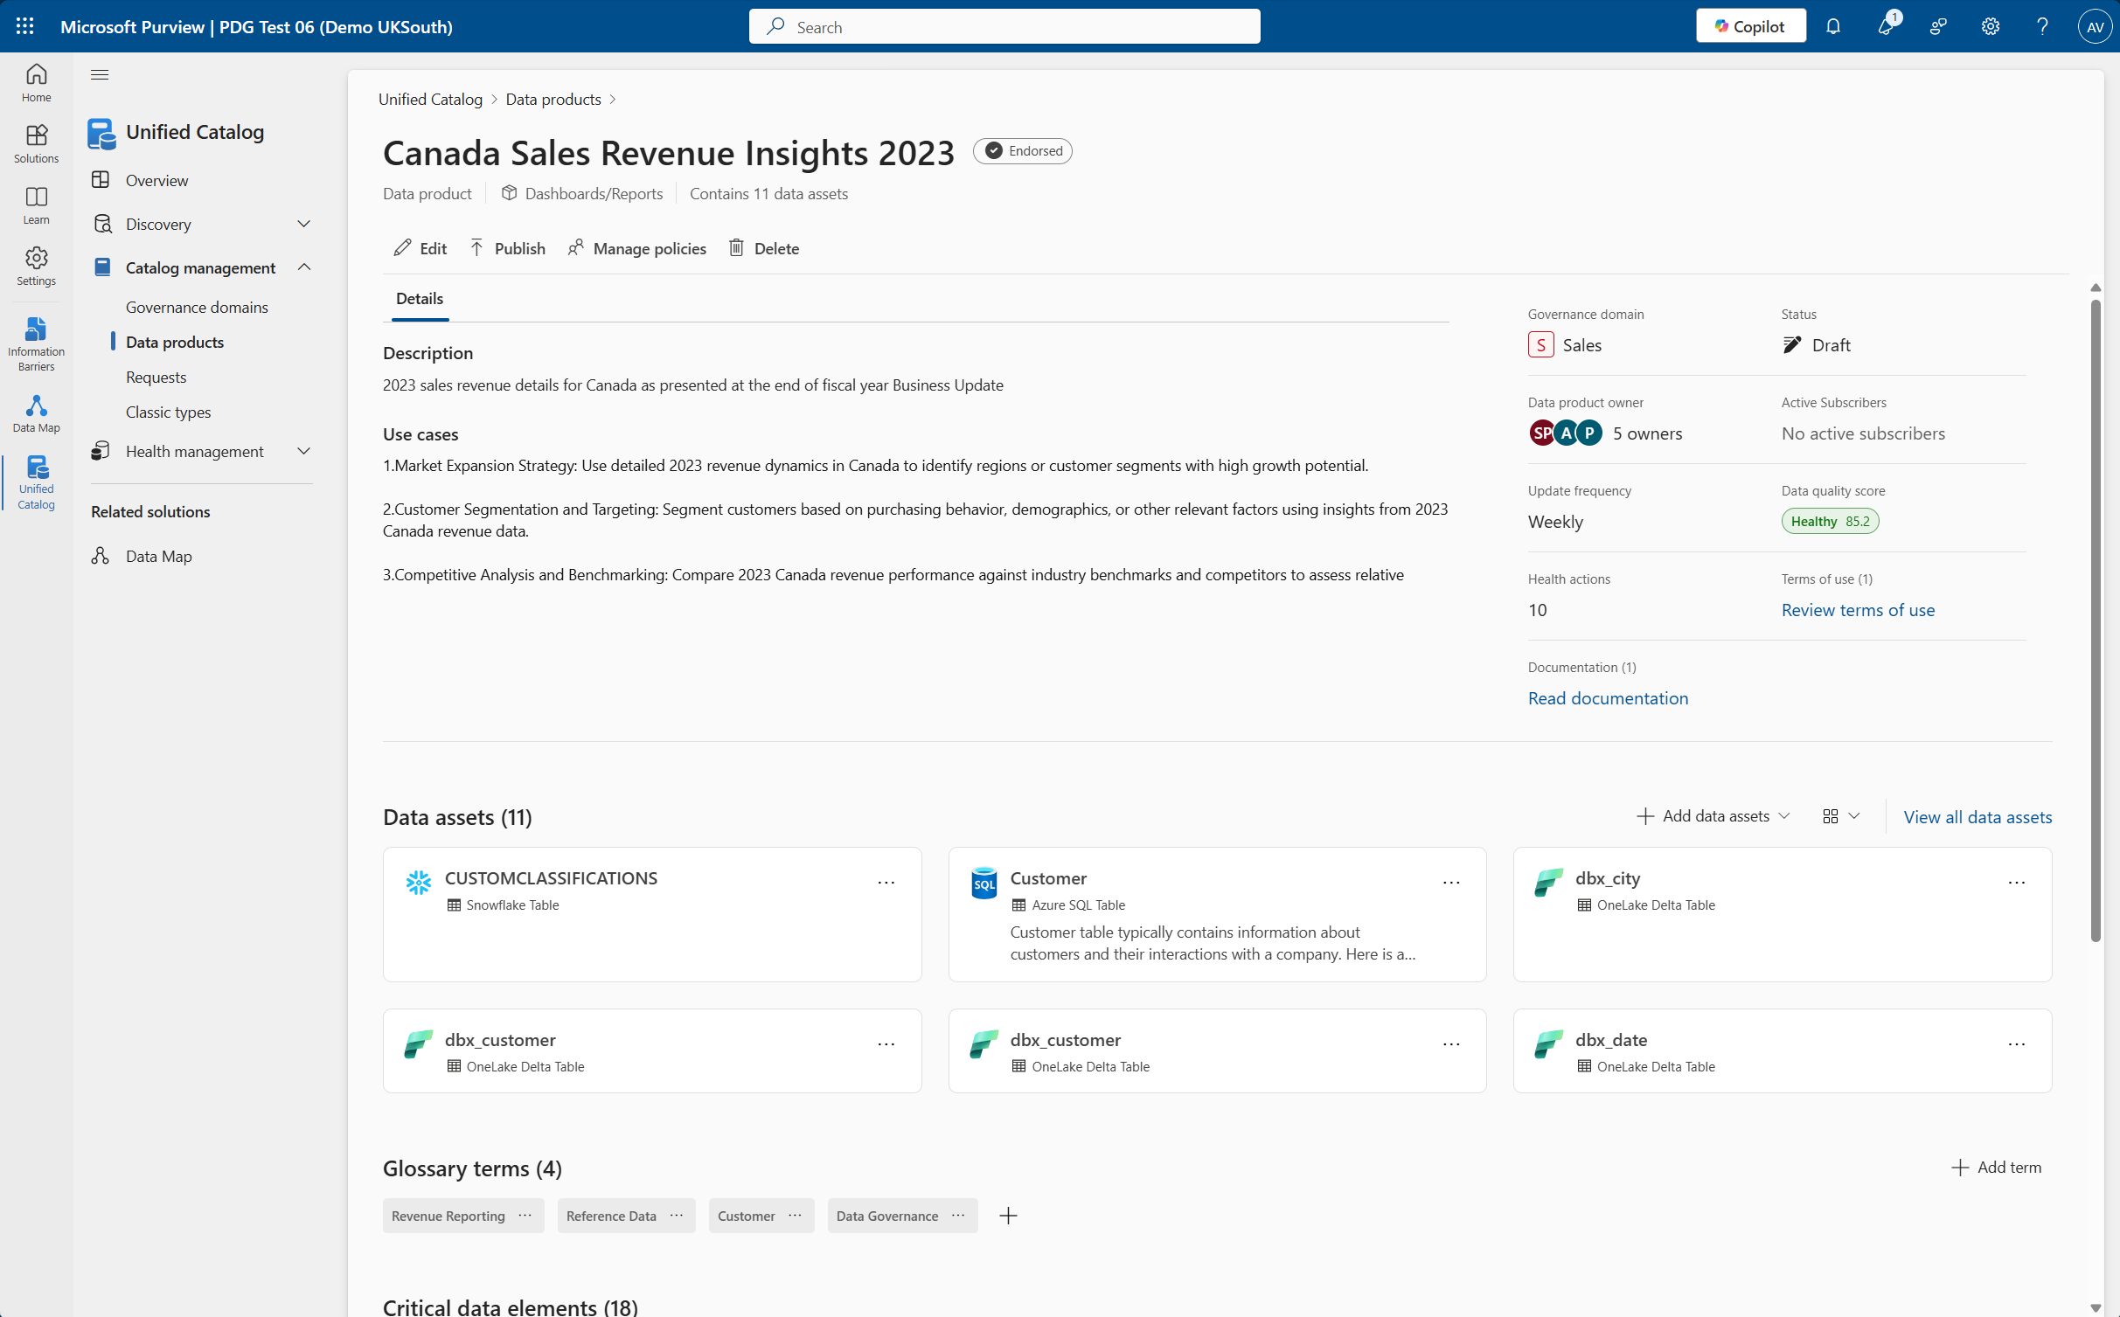
Scalable Data Governance
Streamlined governance:
Data products simplify access requests by grouping related data assets
Users request access to the data product, gaining access to all associated assets after approval
Policy management:
Policies applied to data products automatically apply to all associated assets
Simplifies updates to security and use case policies
Business Health Controls and OKRs
Data products are linked to business health controls and OKRs
Helps data owners assess data health and prioritize assets
Encourages developing business value from data
Notes:
Data products streamline data governance processes
Without data products, users must request access to each data asset individually. Now imagine the time and effort involved—not just for the person requesting access, but for the data owner reviewing each request. As more users begin requesting access across multiple assets, this quickly becomes unsustainable and creates bottlenecks.
With data products, users can request access to a single data product, which—once approved—grants access to all associated data assets. If policies change later, the data owner only needs to update the data product. The changes then apply automatically to all linked assets, ensuring consistency and reducing manual overhead.
Data products are also linked to health metrics, which allows data stewards to monitor asset health, prioritise what needs attention. Data Products also link to glossary terms and OKRs, more on this alter.
Assets are no longer abstract, but tied to real use cases and business objectives – this data product approach supports stronger data governance across your estate and helps shift the focus from managing individual assets to enabling real business outcomes

Slide 4
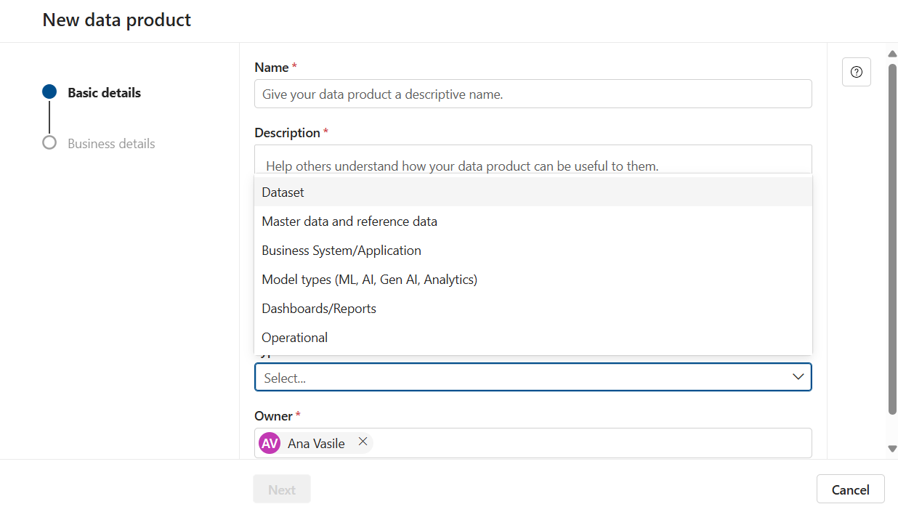
Data Product Types
Dataset: analytical data for reporting and various use cases
Master Data and Reference Data: essential data applicable to all business areas
Business System/Application: Data within a single system or large datasets modeling an entire system for downstream solutions
Model Types (ML, AI, Gen AI, Analytics): notebooks and semantic models providing specific outputs for building new solutions
Dashboard/Reports: visualized data endpoints for decision-makers to gain business insights
Operational: assets needing governance for regulatory purposes, lineage mapping, and source of truth identification
Notes:
When you create a data product, you can optionally identify it as one of the following types. These types help identify the kinds of users that might want to use the data product, and can be used to filter data products in a search.
Dataset - analytical data designed for reporting and other use cases
Master data and reference data - common data that every use case should apply because of its importance to all business areas
Business System/Application- data within a single system or large quantities of data that model an entire system for down stream solutions
Model types (ML, AI, Gen AI, Analytics) - notebooks and semantic models that provide a specific output that others can apply while building new solutions
Dashboards/Reports - a typical end point for data that is visualized and used by decision makers to better understand the business and gain insights
Operational - a group of assets that need to be governed and managed for regulatory purposes, lineage mapping, and source of truth identification

Slide 5
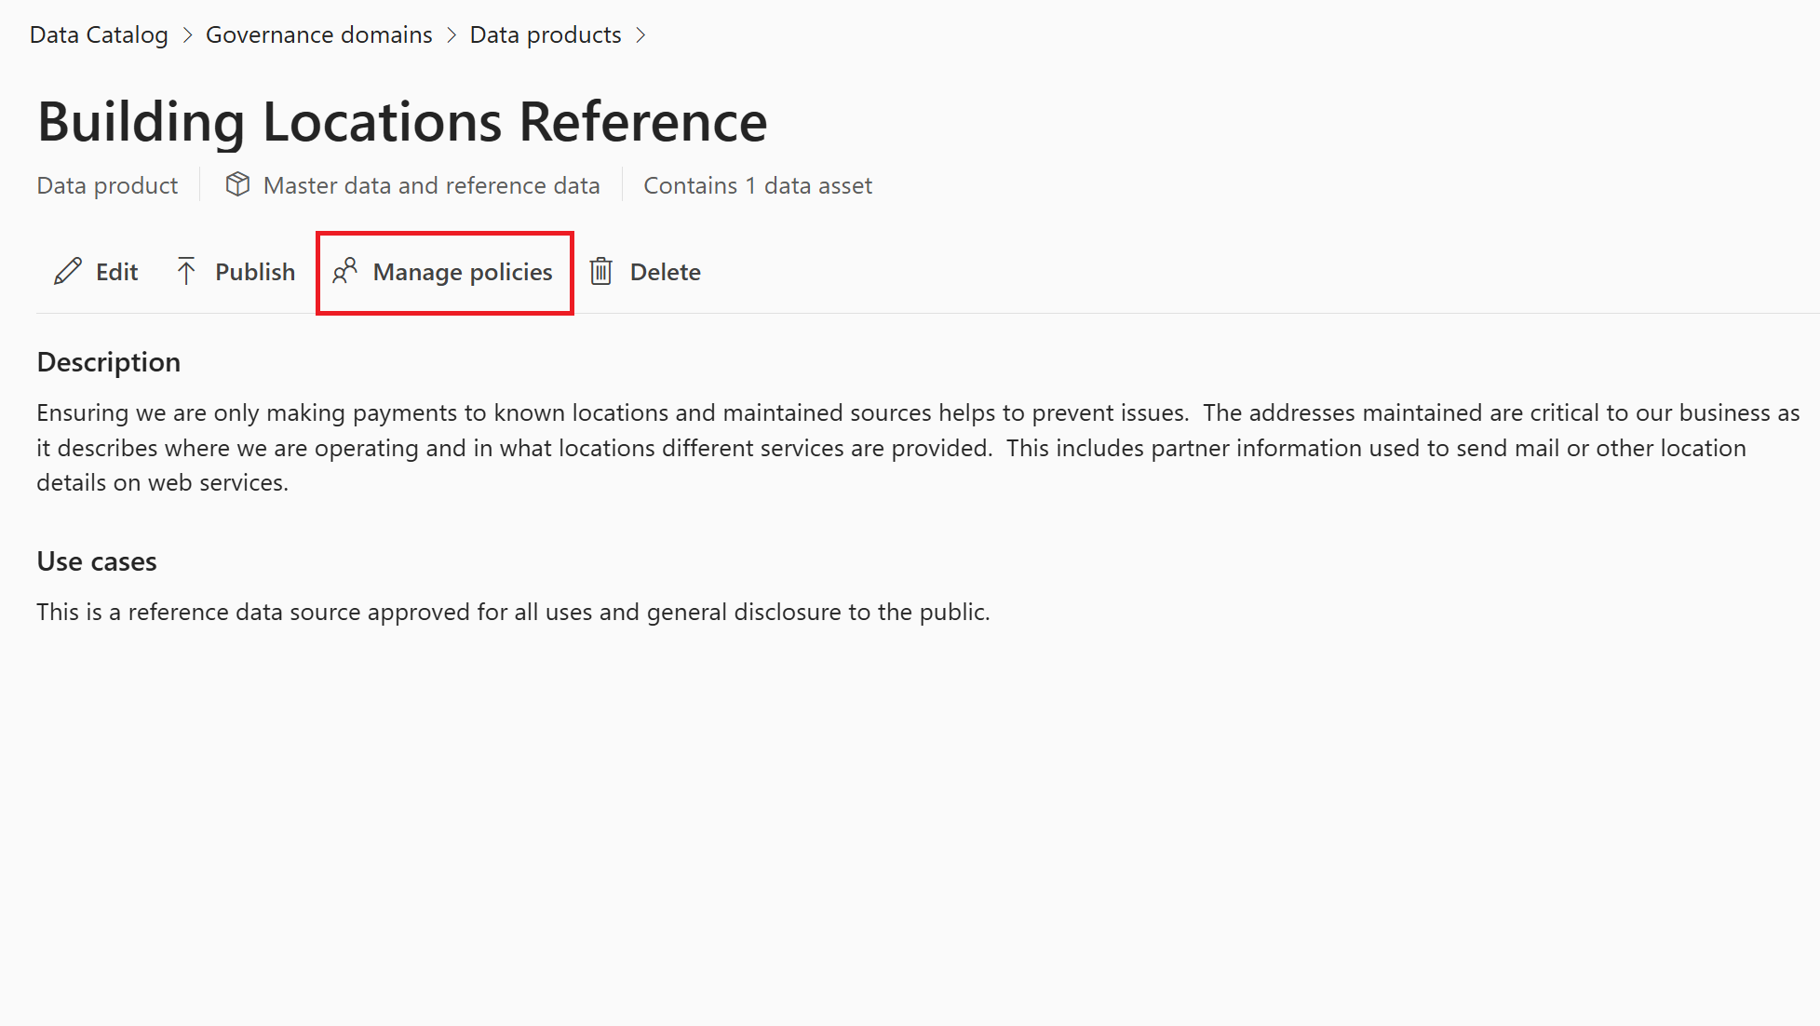
Data Product – Before you publish
1. Add assets
Link the data assets that make up your product.
2. Define access policy
Control who can request access and under what conditions
Notes:
1. Add assets "First, you need to add the underlying data assets. This could be tables, files, reports—whatever makes up the content of the data product. Without this, there’s nothing to serve to consumers."
2. Define access policy "Then, you set an access policy. This defines who can request access to the product and under what conditions. It’s a central point of control, so you don’t need to manage permissions on every individual asset."
Optionally, you can enrich the product by specifying how often it’s updated, linking glossary terms, or even associating it with business OKRs. This helps with discoverability and aligns the product to broader governance and business goals
DONE
Access Policies are essential to ensure that data is used responsibly and in compliance with organizational policies. Data Access defines who can access the data product, what they can do with the data, and under what conditions they can access the data. Access policies are defined at the data product level and enforced across all data assets within it.
To manage access policies, you need data product owner or data steward permissions.
If your data product is published, first it needs to be unpublished to manage policies.
On your data product page, select Manage policies.
From the policy configuration window, you're able to create and manage your data product's access policy. Learn how to set up data product access policies.

Slide 6
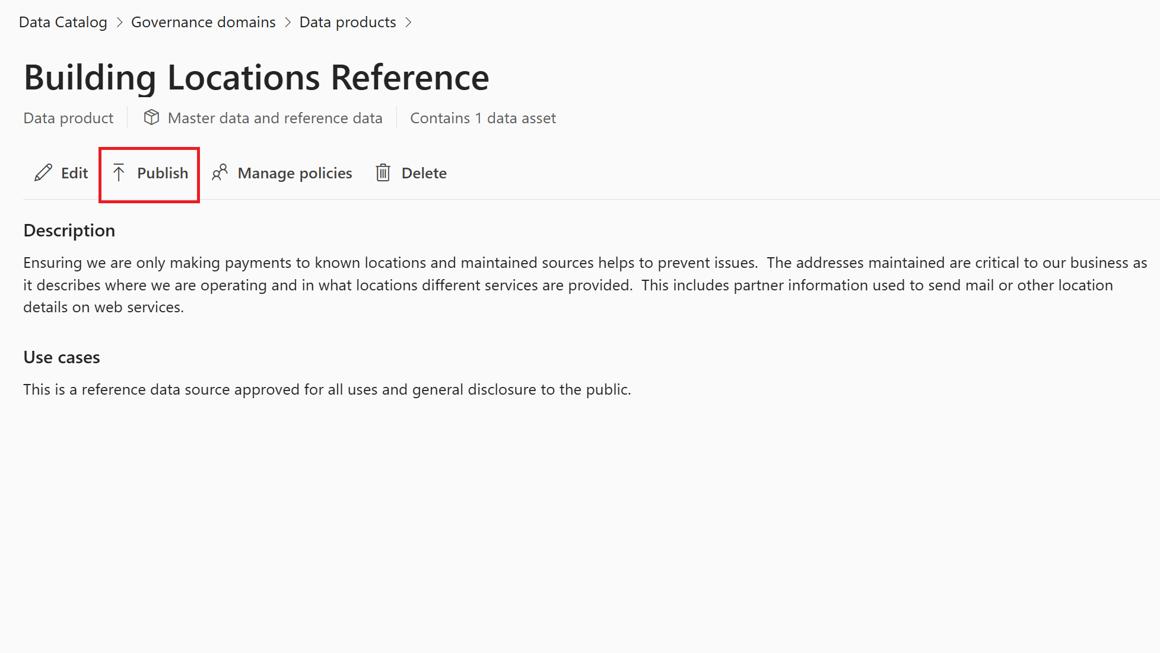
Data Product – Publish and Draft
To publish a drafted data product, you can select the Publish Button to make it available to the users.
Important Note - before you can publish, you need to add data assets to your product, and set up data access policies so users can request access to the data product
- Your governance domain must also be published
Notes:
To publish a drafted data product, you can select the Publish button next to the edit button. Before you can publish, you need to add data assets to your data product, and set up a data access policy so users can request access to your data product.
After completing the requirements, you can publish your data product, which will make the data product available for users in Unified Catalog.
You can also set a previously published data product to a draft by unpublishing it:
Select the Unpublish button in the data product.
Select Set to draft which will allow only stewards, governance domain owners, and data product owners to view and manage it.
You can also set your data product to Expired:
Select the Unpublish button in the data product.
Select Set to expired which makes it visible only to stewards, governance domain owners, and data product owners.

Slide 7
Module - 6
Lab time!

